Slide 1

IPL MATCHES MANAGEMENT (All-Star Games)
By
Chirag Radhakrishna-1VI19CS021
Chiranjeevi PR-1VI19CS022
Under the Guidance of
Prof. Naveen H S
Assistant Professor

Slide 2
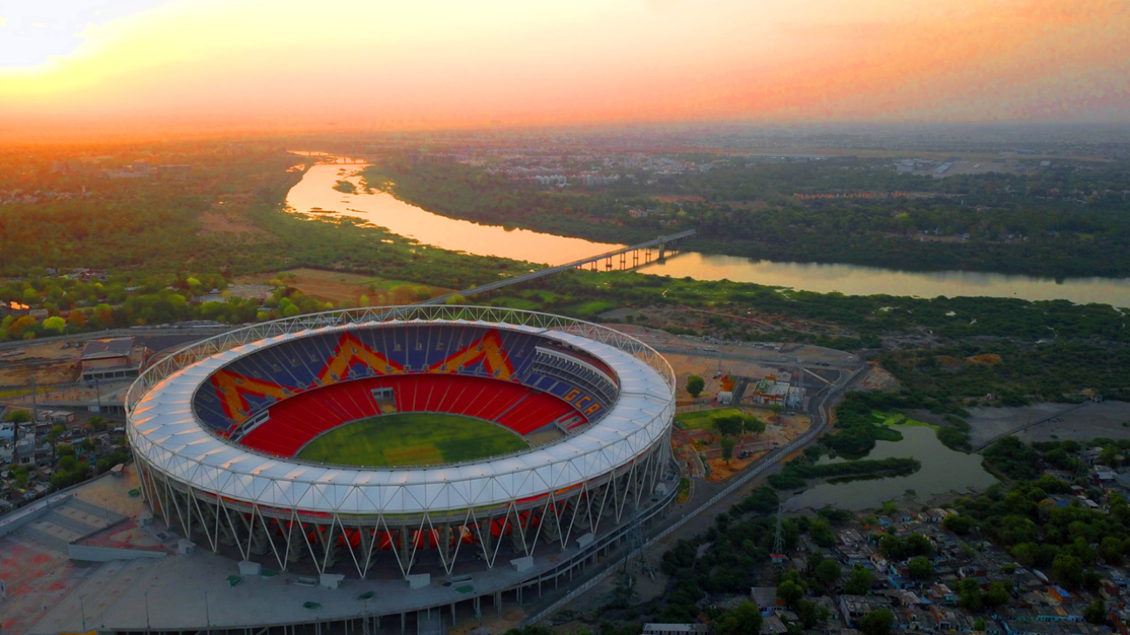
IPL ALL-STAR GAMES 2022

Slide 3






AGENDA
The aim of the project is to build an application that allows fans to purchase tickets to the IPL All-Star Games 2022.

Slide 4
ABSTRACT
The IPL All-Star Games comprises of 8 teams playing at the Sardar Vallabhai Patel Stadium. This application provides users/fans a platform to view the teams, the players and book tickets for a match of their choice.
This application is robust, user-friendly, yet easy and simple to use. It is based on the concept of database connectivity i.e., connecting a suitable front-end tool to a DBMS.
By making use of a database like MySQL, storing users’ data and ticket details becomes simpler and can be retrieved accordingly.
Since this application is a seat booking system which allows booking of All-Star game tickets online, it can be classified under the category of Electronic business (E-Business).
“E-business refers to any form of transaction (exchange) that uses an electronic medium to facilitate the transaction.”

Slide 5
INTRODUCTION
Basic overview of the project-
There are 8 teams participating in the All-Star Games. The user can view the teams and its players and select a match accordingly.
The matches are part of a round –robin format wherein the teams face off against each other. Details of the matches are stored in MySQL table.
If the user is interested in booking a seat for an All-Star Game, he/she can do so by selecting the desired seat through the interactive seat booking frame model.
Once the match and the seats have been selected, the user is taken to a payment form, where he/she can pay via credit card or debit card by giving valid details.
Once the formalities are finished, a final ticket frame consisting of all the match and ticket details will be displayed automatically. The user can then logout after saving his/her details.
There is also provisions for the owner of the application, who can view the customer match data and get an idea of how many seats are booked for the All-Star games respectively.

Slide 6
Customer Data
Customer Match Data
SYSTEM ARCHITECTURE
Database
Matches Data
TEAMS
MATCHES
USER LOGIN
SEAT SELECTION
PAYMENT
GENERATE TICKET
LOGOUT

Slide 7
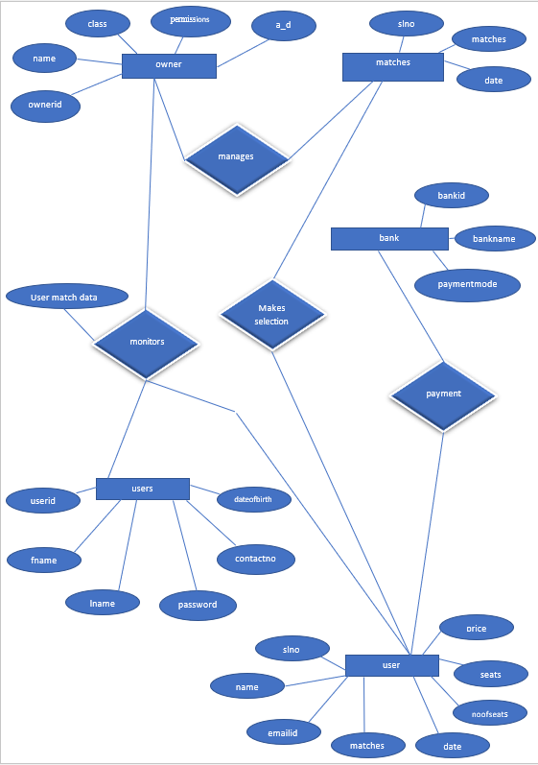
ER DIAGRAM

Slide 8
OWNER
S C H E M A D I A G R A M
ownerid | name | class | permissions | a_d
MATCHES
slno | matches | date
USERS
userid | fname | lname | password | contactno | dateofbirth
USER
slno | name | emailid | matches | date | noofseats | seats | price
BANK
bankid | bankname | paymentmode

Slide 9
IMPLEMENTATION
Front-end tool used is NetBeans IDE (Java).
Back-end tool [database] used is MySQL Database.
NetBeans IDE and MySQL have been linked using JDBC.
JDBC helps to connect to a relational database (Ex: MySQL) from within a Java Application. It is done it using the JDBC API of Java.

Slide 10
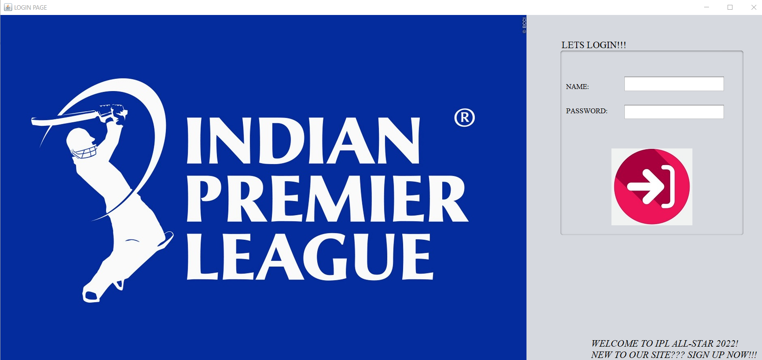
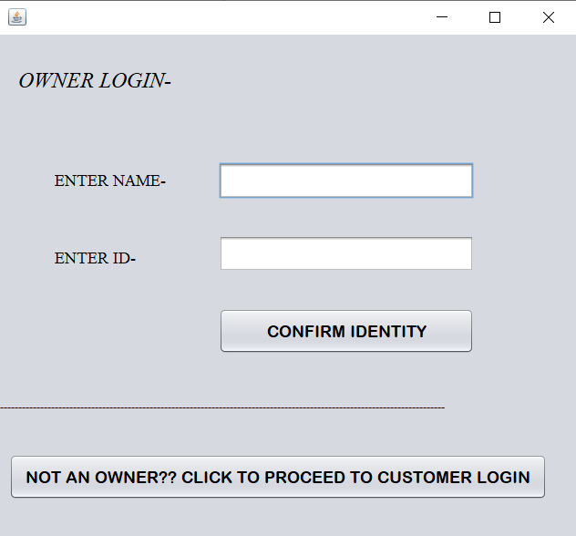
SNAPSHOTS
Application Flow…..
Owner sign-in page
User log-in page

Slide 11
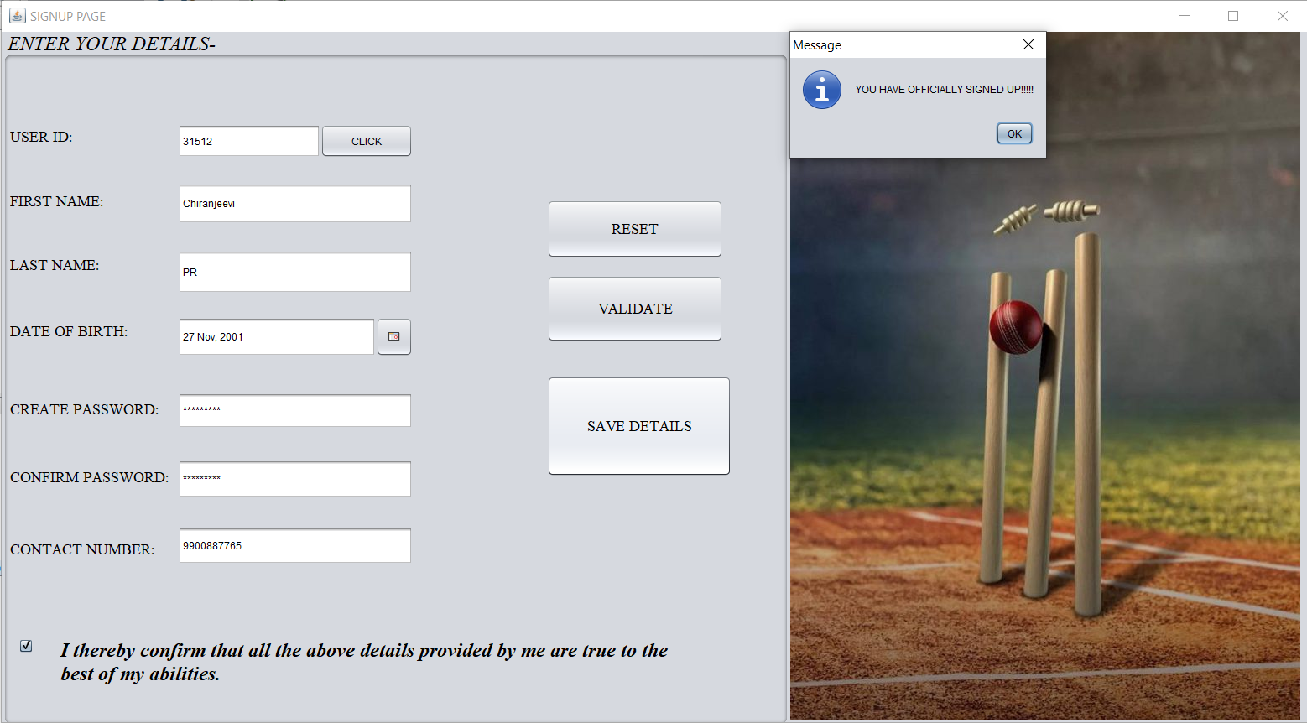

User can sign-up by creating an account.
User will be able to log-in
after creating an account.

Slide 12
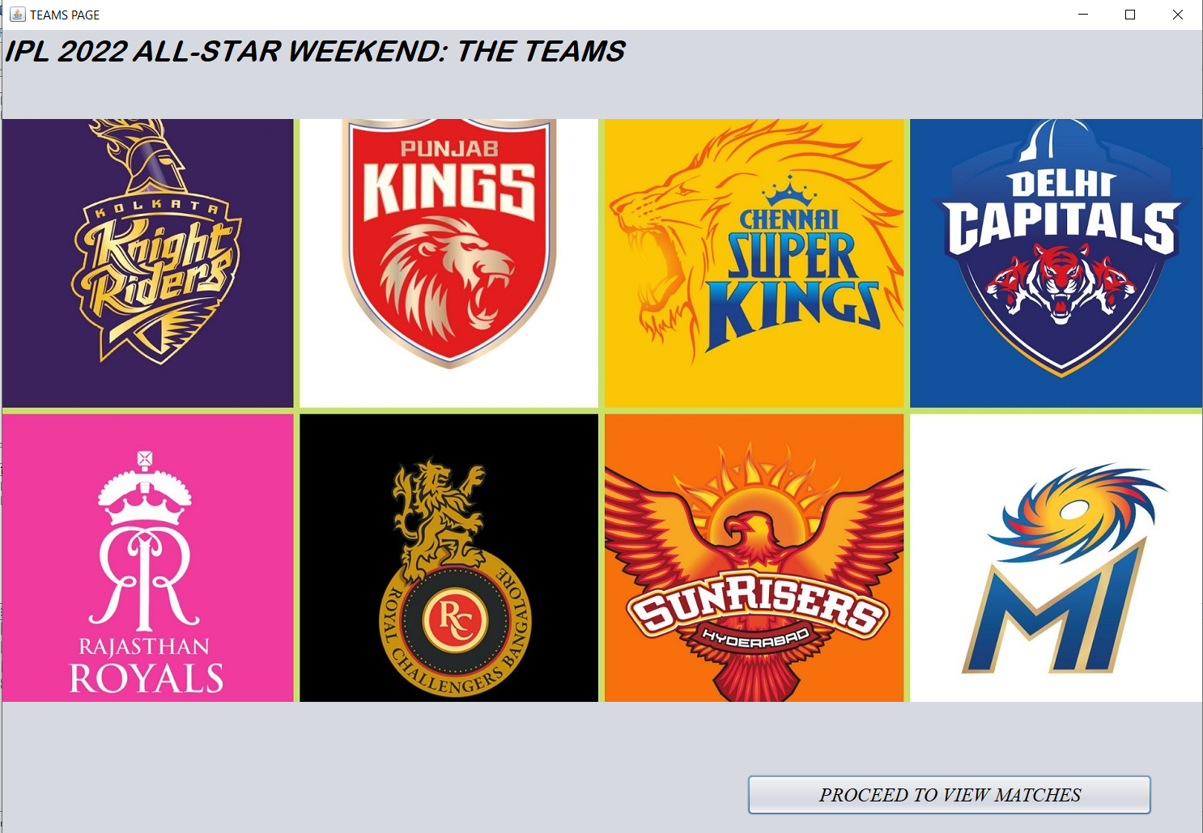
User can view the teams participating in the All-Star games.

Slide 13
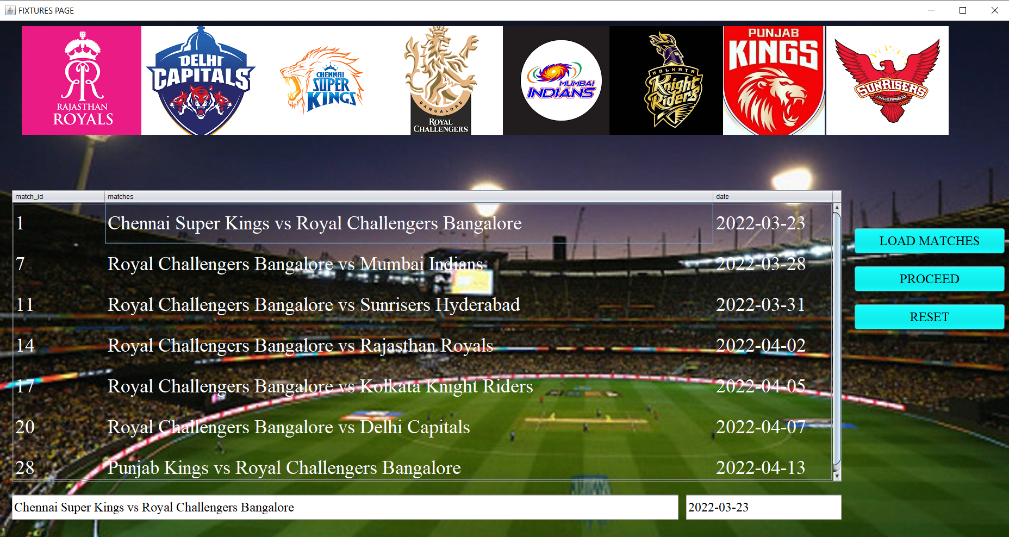
User can select a match by clicking a team logo and loading the respective matches…

Slide 14
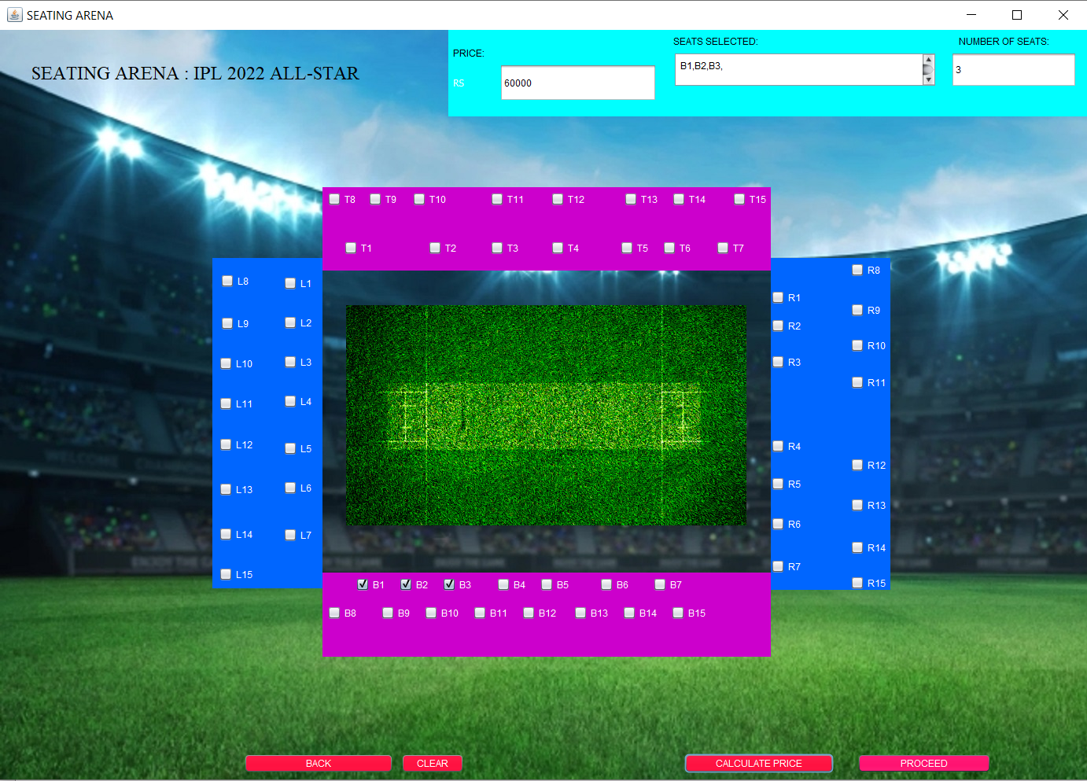
After selecting a match, the user can select a maximum of 5 seats….

Slide 15
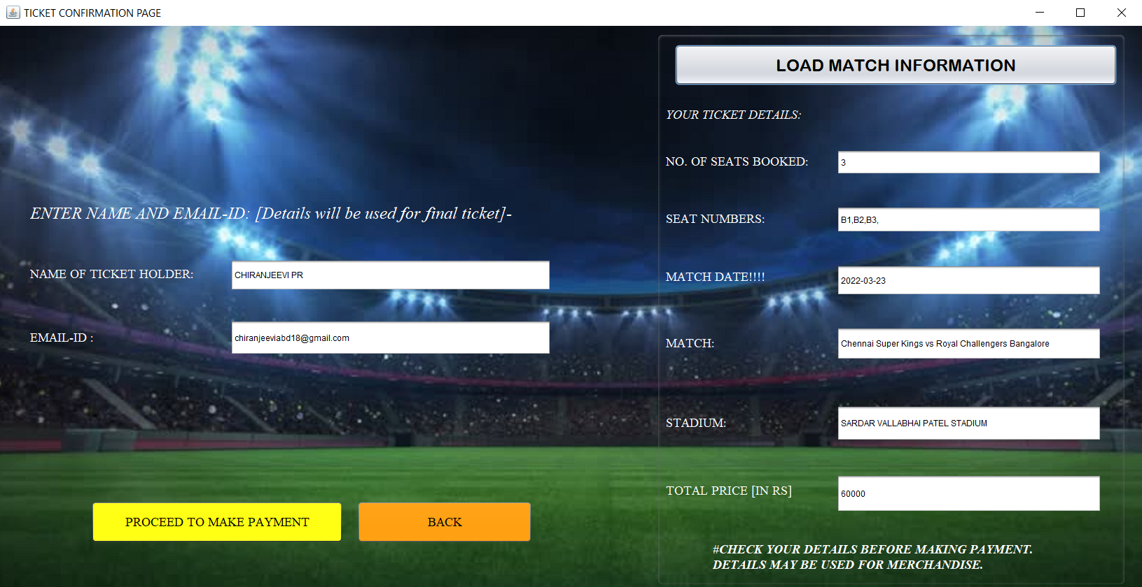
After selecting the seats, the user can cross-check his/her match details before proceeding to make the payment…..

Slide 16
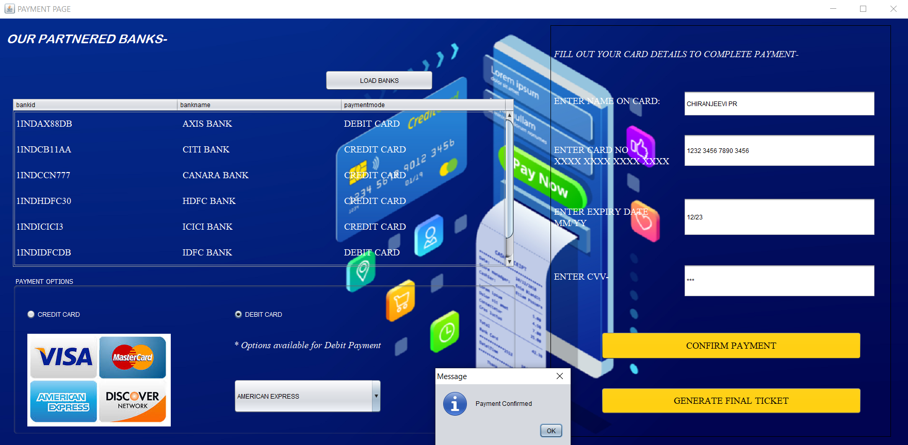
The user makes the payment by selecting a payment-method of his/her convenience…..

Slide 17
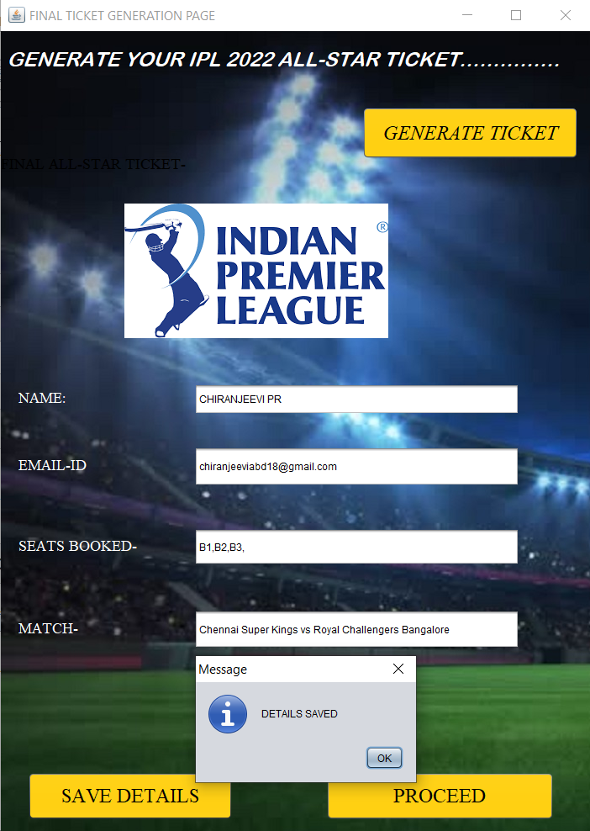
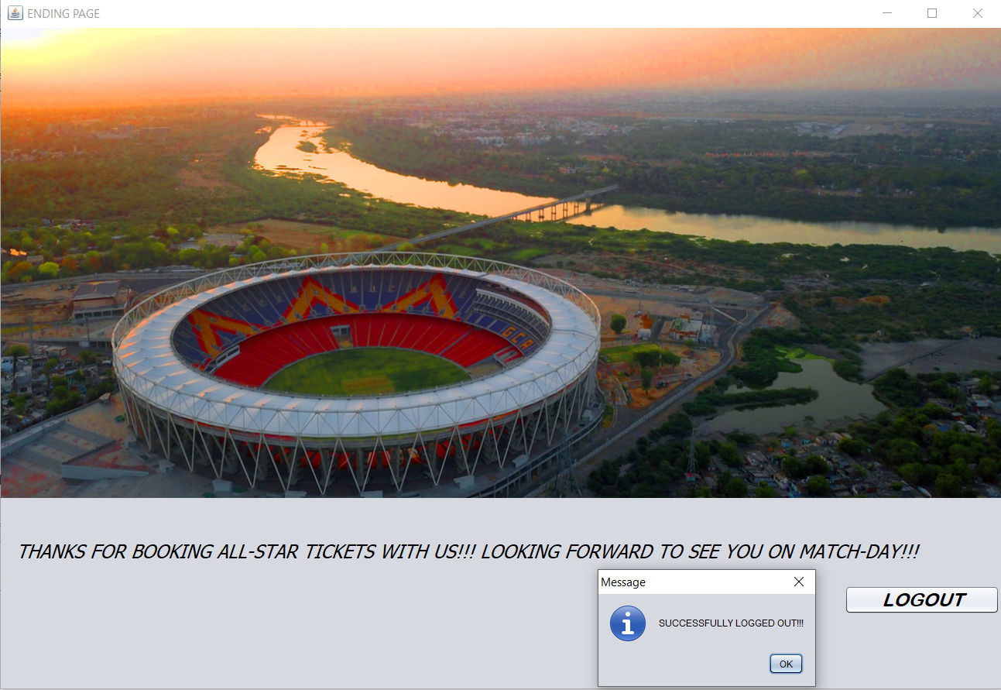
User can generate his/her final ticket and can save the match details and logout.

Slide 18
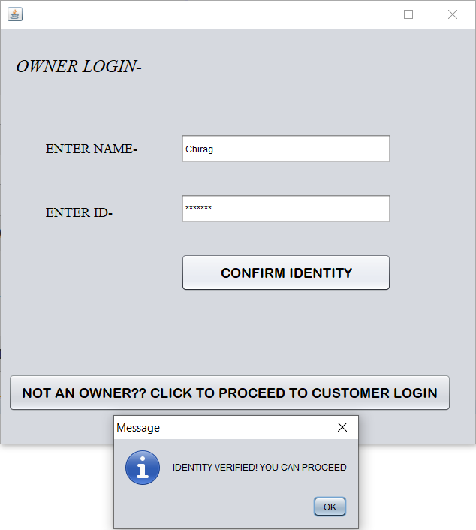
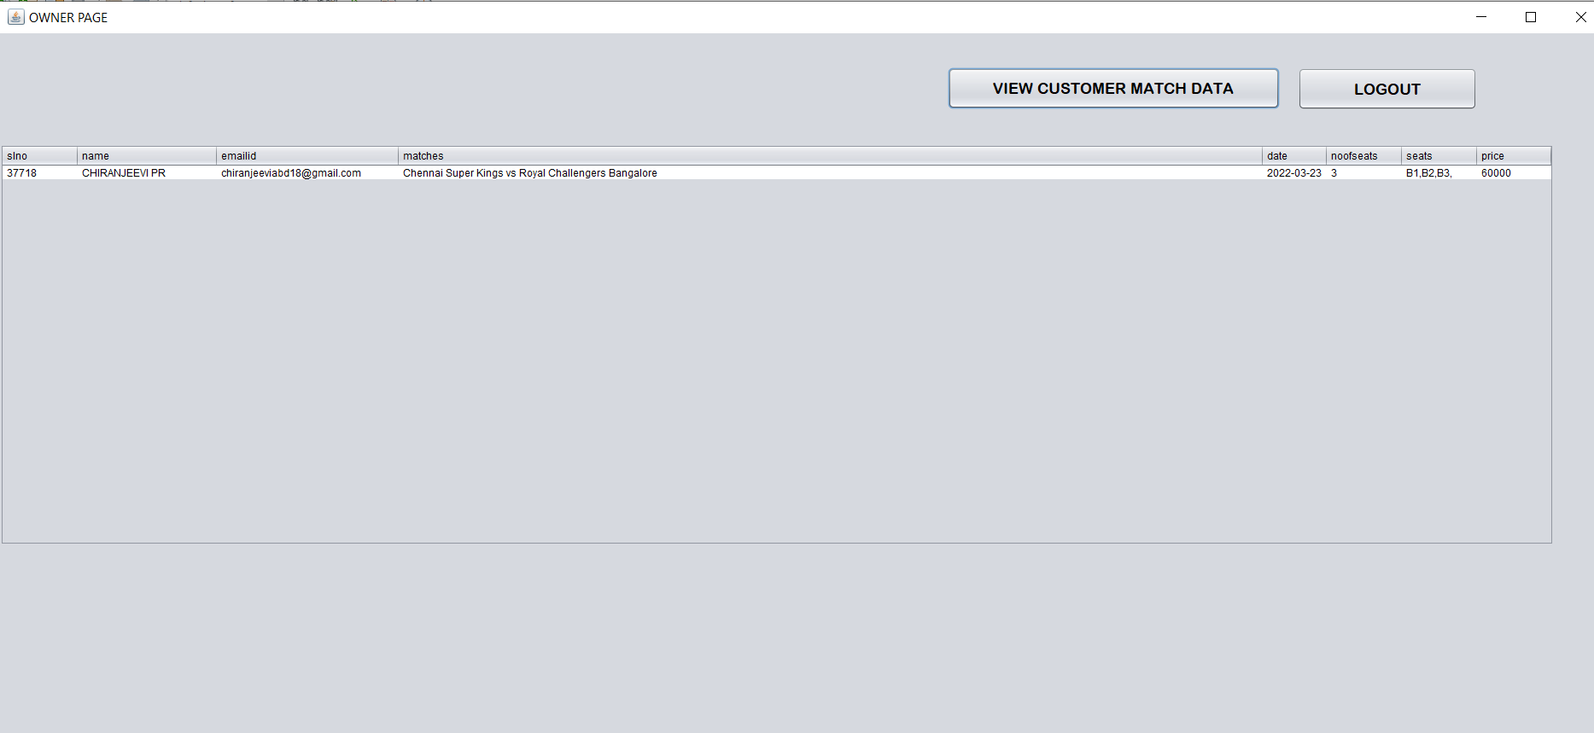
The owner of the application can view match details of customers’ to get an idea of how many seats are being booked.

Slide 19
REFERENCES
Sumita Arora: informatics practices
https://www.tutorialspoint.com/index.htm
https://www.wikipedia.org/

Slide 20
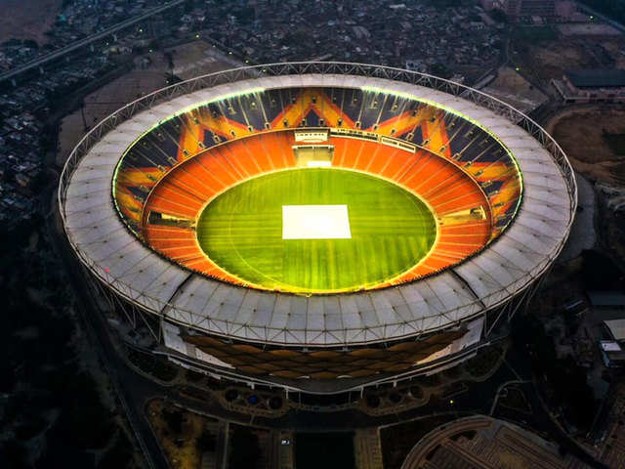
THANK YOU

